Slide 1
“Samantha”
A Soap Opera and Vocabulary Book
For Students of English as a Second Language
By: Meryl Robin Becker
Presented by: Angela McCurdy

Slide 2
Why a Soap Opera?
Three Main Reasons why I chose this subject -
- Great learning/review and use of Vocabulary
- Learning and using Idioms
- Who doesn’t love a “Juicy” story?!

Slide 3
The Soap Opera
- My students love a good story!
- Materials that I present have to be interesting or students lose interest.
- This soap opera gives the classroom a good discussion.
- Keeps students engaged in reading.
- Good for learning new vocabulary and reading comprehension.
- Students return each week for the next chapter.

Slide 4
The Juicy Soap Opera
A FEW IDEAS…..
I have my class days broken up into sections. Monday is reading, Tuesday is speaking, Wednesday is writing and Thursday is listening.
This book covers all of these sections. We read, we discuss, we write and we listen.
Every Monday is “Soap Opera” day.
I don’t allow students to read ahead, we do one chapter at a time. (helps with the students predicting what they think will happen)
Have students take turns reading the story – (then quiz on comprehension)

Slide 5
The Juicy Soap Opera
  (after comprehension quiz) have students make predictions about what they think is going to happen.
  Class discussions - listen to different points of views.
  (**while being respectful of everyone**)
  If discussion is difficult to get going, separate in groups and assign each group a point of view to take sides on.

Slide 6
The Juicy Soap Opera
  Have students get involved and act out the parts if possible.
  Make it fun.
  On Tuesday, (speaking day) I type up the questions and have the students come up and draw one out of the basket, read the question and then give their answer.

Slide 7
VOCABULARY
Each chapter has different sections. The first section starts with the list of vocabulary/idioms and definitions.
Notice how some words can be a noun, verb, adjective, preposition etc.
After reviewing all the vocabulary, in the next section, students then have the opportunity to practice the new or reviewed vocabulary.
After reading the soap opera episode, I have my students underline all the vocabulary words.

Slide 8
VOCABULARY
This book includes lots of different activities such as:
  inserting the vocabulary words into sentences
  inserting the idiom phrases into sentences
  doing vocabulary crossword puzzles
  word searches
  unscrambling the vocabulary words
  vocabulary/definition matching
  you could have the students put the words in alphabetical order….etc

Slide 9
VOCABULARY
Vocabulary is critical to reading success for three reasons:
https://www.scholastic.com/teachers/articles/teaching-content/understanding-vocabulary/
  Comprehension improves when you know what the words mean. Since comprehension is the ultimate goal of reading, you cannot overestimate the importance of vocabulary development.
  Words are the currency of communication. A robust vocabulary improves all areas of communication — listening, speaking, reading and writing.
  How many times have you asked your students or your own children to “use your words"? When children and adolescents improve their vocabulary, their academic and social confidence and competence improve, too.

Slide 10
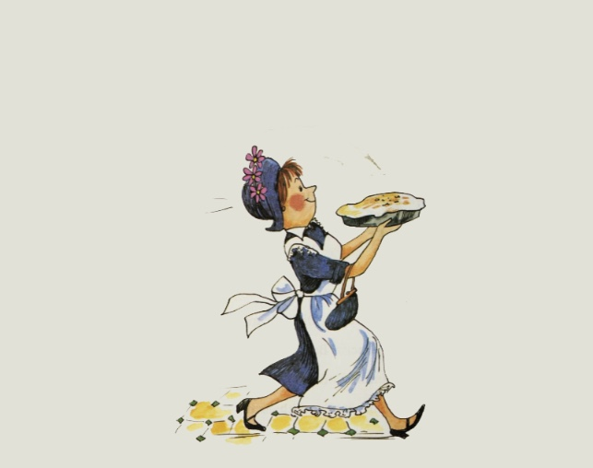

IDIOMS
My students love learning idioms!!

Slide 11
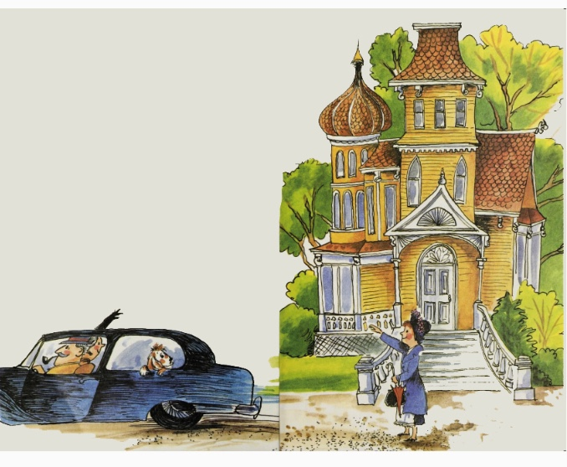
Amelia Bedelia
“”Oh Amelia Bedelia, your first day of work, and I can’t be here. But I made a list for you. You do just what the list says,” said Mrs. Rogers. Mrs. Rogers got into the car with Mr. Rogers. They drove away.

Slide 12
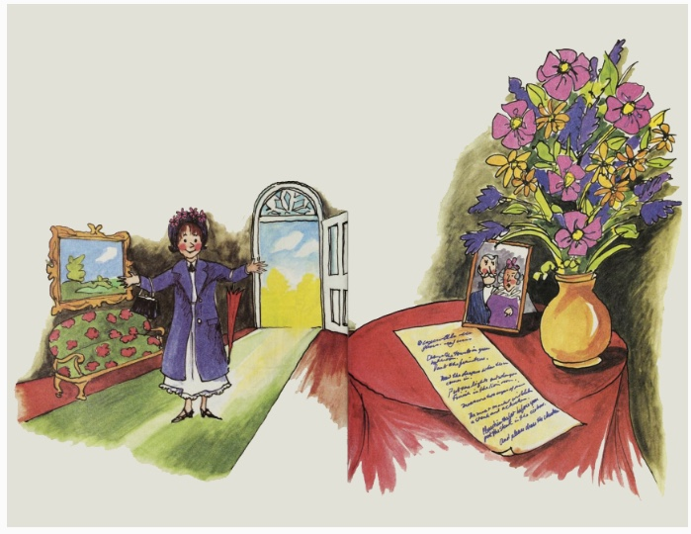
Amelia Bedelia
“My, what nice folks. I’m going to like working here,” said Amelia Bedelia.

Slide 13
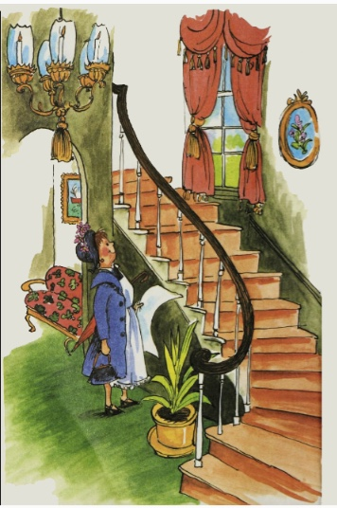
Amelia Bedelia
Amelia Bedelia went inside. “Such a grand house. These must be rich folks. But I must get to work. Here I stand just looking. And me with a whole list of things to do.” Amelia Bedelia stood there a minute longer. “I think I’ll make a surprise for them. I’ll make lemon-meringue pie. I do make good pies.”

Slide 14
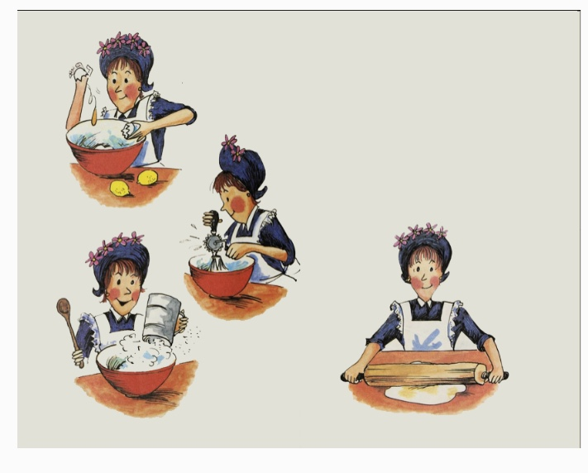
Amelia Bedelia
So Amelia Bedelia went into the kitchen. She put a little of this and a pinch of that into a bowl. She mixed and rolled.

Slide 15
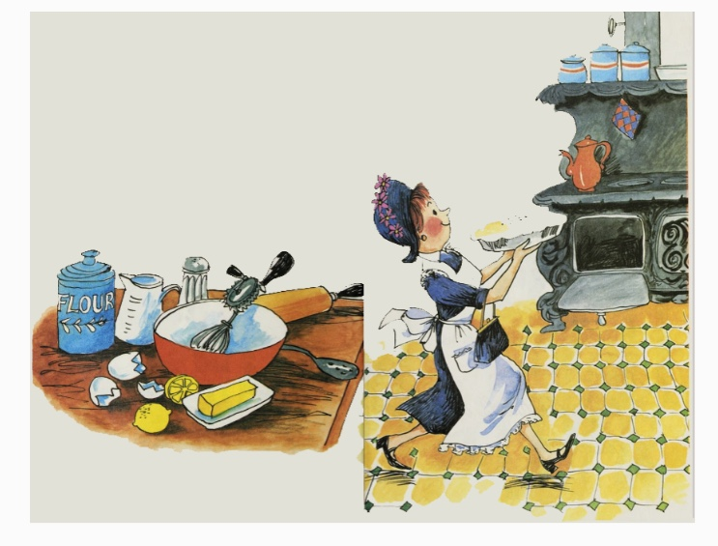
Amelia Bedelia
Soon her pie was ready to go into the oven. “There,” said Amelia Bedelia “That’s done.”

Slide 16
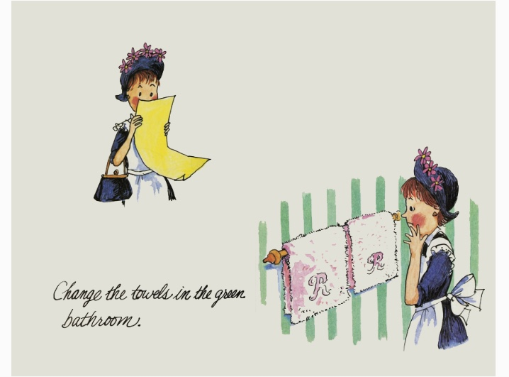
Amelia Bedelia
“Now let’s see what the list says.” Amelia Bedelia read, Amelia Bedelia found the green bathroom. “Those towels are very nice, why change them?” She thought, then Amelia Bedelia remembered what Mrs. Rogers had said.

Slide 17
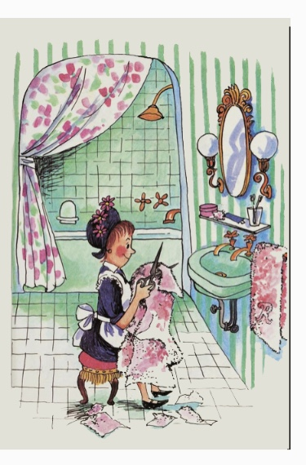
Amelia Bedelia
She must do just what the list told her. “Well, all right,” said Amelia Bedelia. Amelia Bedelia got some scissors. She snipped a little here and a little there. And she changed those towels.

Slide 18
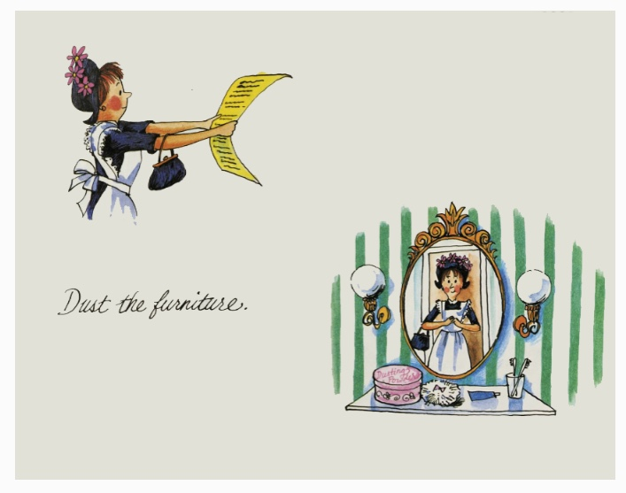
Amelia Bedelia
“There” said Amelia Bedelia. She looked at her list again. “Did you ever hear tell of such a silly thing. At my house we undust the furniture, but to each is own way.” Amelia Bedelia took one last look at the bathroom. She saw a big box with the words ‘dusting’ powder on it. “Well, look at that a special powder to dust with!” Exclaimed Amelia Bedelia.

Slide 19
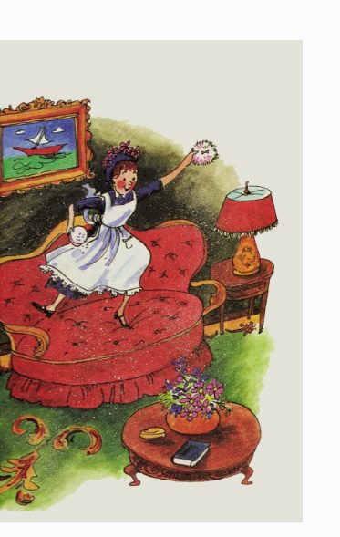
Amelia Bedelia
So Amelia Bedelia dusted the furniture. “That should be dusty enough. My, how nice it smells.”

Slide 20
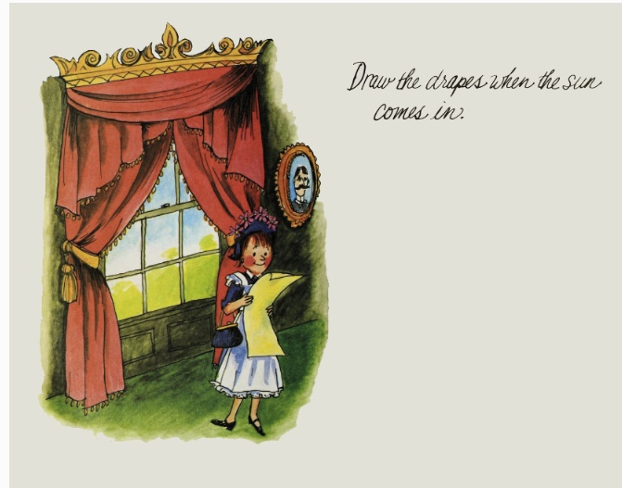
Amelia Bedelia
Amelia Bedelia read, she looked up. The sun was coming in. Amelia Bedelia looked at the list again. “Draw the drapes? That’s what it says. I’m not much of a hand at drawing, but I’ll try.”

Slide 21
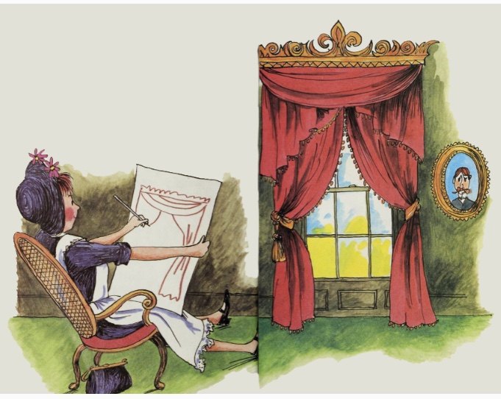
Amelia Bedelia
So Amelia Bedelia sat right down and she drew those drapes. Amelia Bedelia marked off about the drapes.

Slide 22
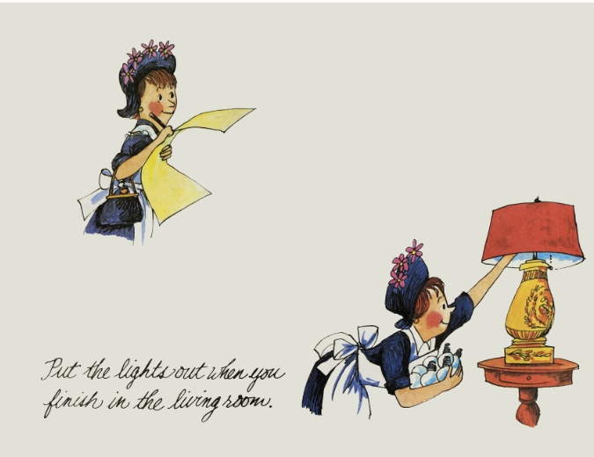
Amelia Bedelia
“Now what?” Amelia Bedelia thought about this a minute. She switched off the lights. Then she carefully unscrewed each bulb.

Slide 23
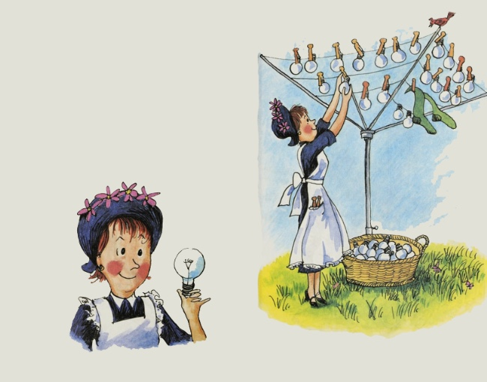
Amelia Bedelia
And Amelia Bedelia put the lights out. “So those things need to be aired out, too. Just like pillows and babies. Oh, I do have a lot to learn.”

Slide 24
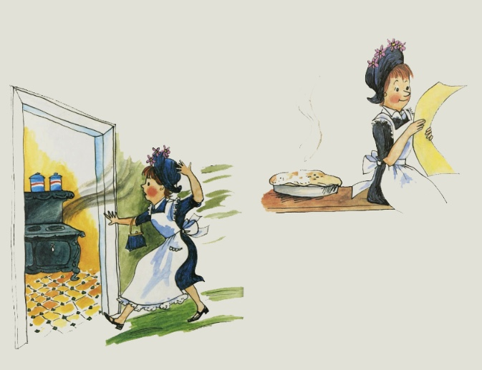
Amelia Bedelia
“My pie!” exclaimed Amelia Bedelia. She hurried to the kitchen. “Just right,” she said. She took the pie out of the oven and put it on the table to cool. Then she looked at the list.

Slide 25
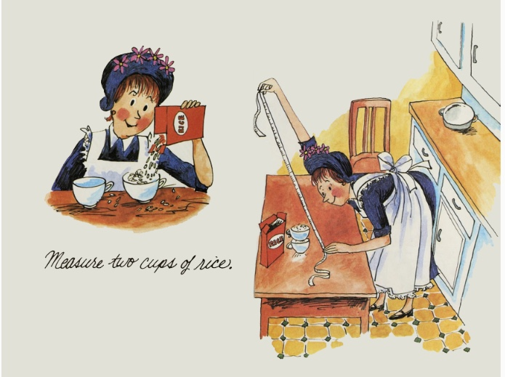
Amelia Bedelia
“That’s next,” said Amelia Bedelia. Amelia Bedelia found two cups. She filled them with rice. And Amelia Bedelia measured that rice.

Slide 26
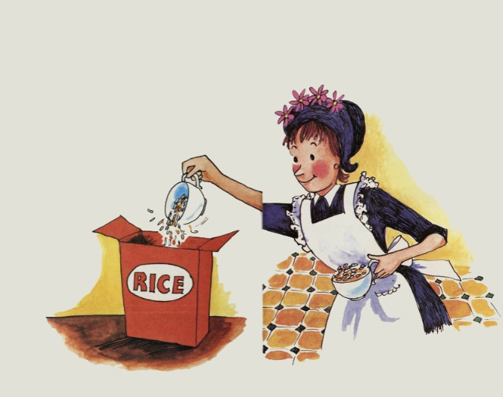
Amelia Bedelia
Amelia Bedelia laughed. “These folks do want me to do funny things.” Then she poured the rice back into the container.

Slide 27
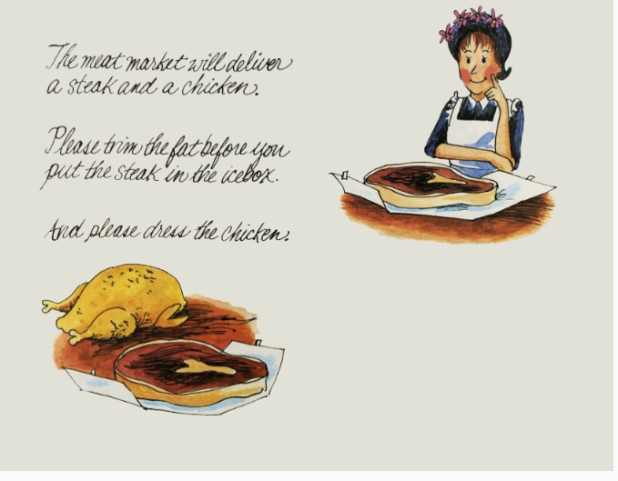
Amelia Bedelia
When the meat arrived, Amelia Bedelia opened the bag. She looked at the steak for a long time. “Yes,” she said. “That will do nicely.”

Slide 28
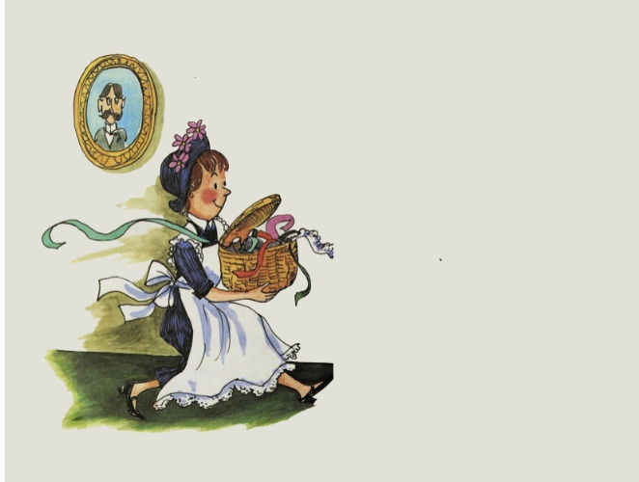
Amelia Bedelia
Amelia Bedelia got some lace and bits of ribbon. And Amelia Bedelia trimmed that fat before she put the steak in the icebox.

Slide 29
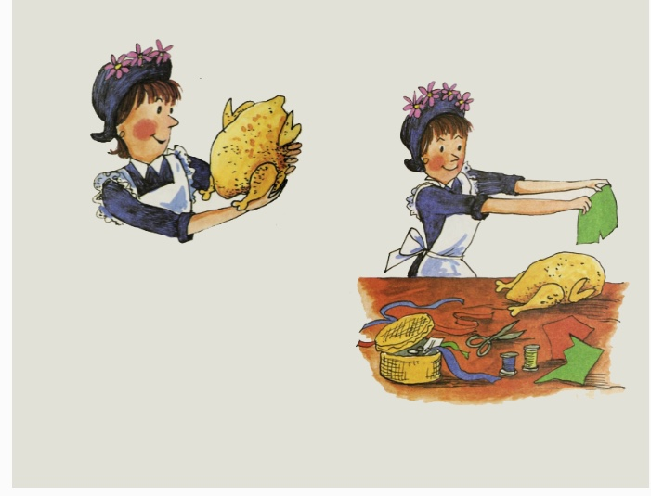
Amelia Bedelia
“Now I must dress the chicken. I wonder if she wants a he chicken or a she chicken?” said Amelia Bedelia. Amelia Bedelia went right to work. Soon the chicken was finished.

Slide 30
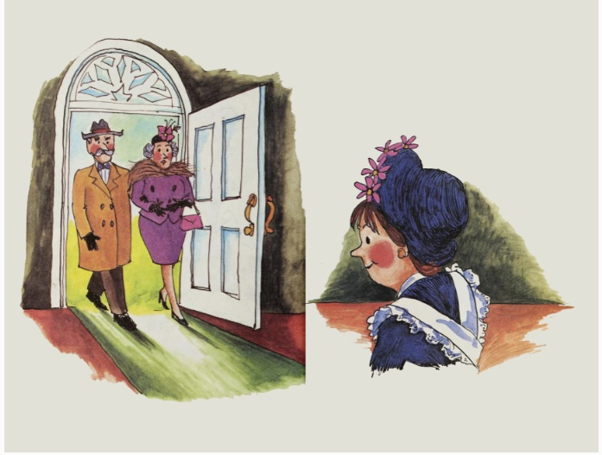
Amelia Bedelia
Amelia Bedelia heard the door open. “The folks are back,” she said. She rushed out to meet them.

Slide 31
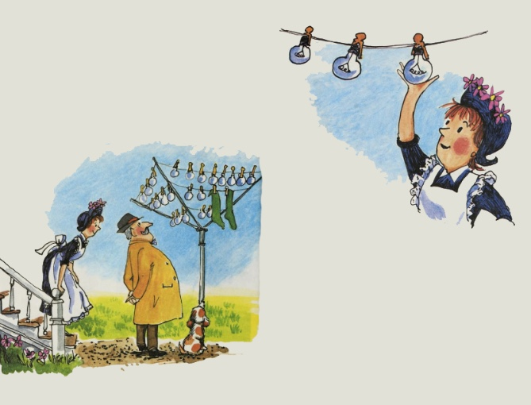
Amelia Bedelia
“Amelia Bedelia, why are the light bulbs outside?” asked Mr. Rogers. “The list said to put the lights out,” said Amelia Bedelia. “It didn’t say to bring them back in. Oh, I do hope they didn’t get aired too long.”

Slide 32
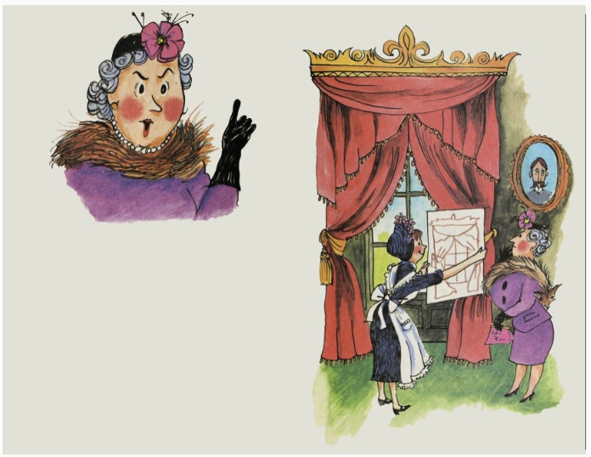
Amelia Bedelia
“Amelia Bedelia, the sun will fade the furniture. I asked you to draw the drapes,” said Mrs. Rogers. “I did! I did! See,” said Amelia Bedelia. She help up her picture.

Slide 33
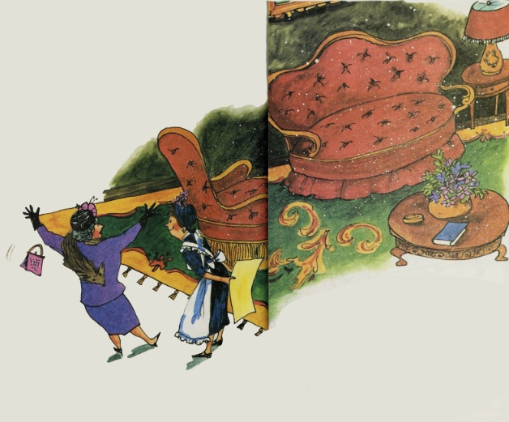
Amelia Bedelia
Then Mrs. Rogers saw the furniture. “The furniture!” she cried. “did I dust it well enough?” asked Amelia Bedelia. “That’s such nice dusting powder.”

Slide 34
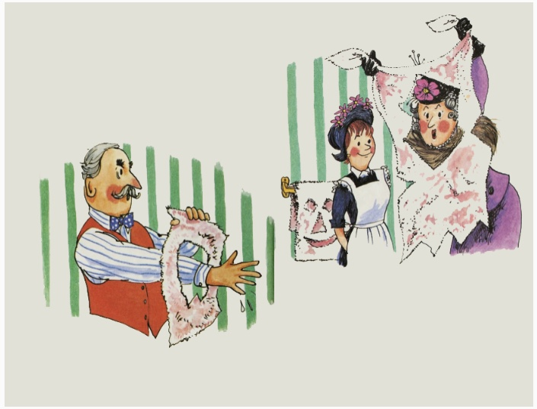
Amelia Bedelia
Mr. Rogers went to wash his hands. “I say,” he called. “These are very unusual towels.” Mrs. Rogers dashed into the bathroom. “Oh my best towels,” she said. “Didn’t I change them enough?” asked Amelia Bedelia.

Slide 35
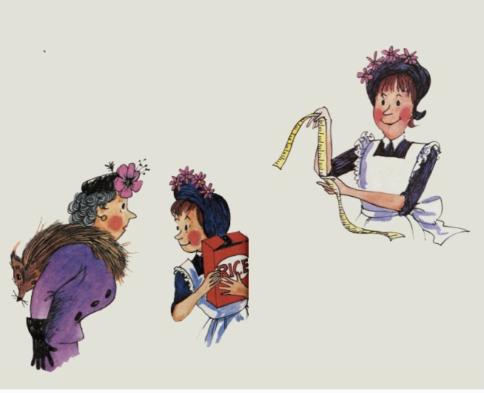
Amelia Bedelia
Mrs. Rogers went to the kitchen. “I will cook the dinner. Where is the rice I asked you to measure?” “I put it back in the container. But I remember – it measured four and a half inches,” said Amelia Bedelia.

Slide 36
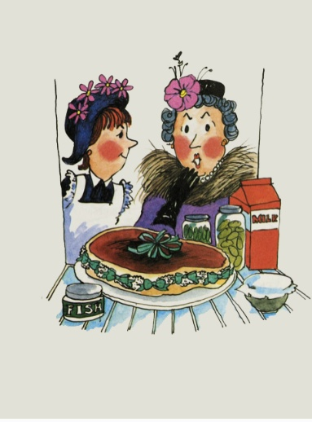
Amelia Bedelia
“Was the meat delivered?” asked Mrs. Rogers. “Yes,” said Amelia Bedelia. “I trimmed the fat just like you said. It does look nice.” Mrs. Rogers rushed to the icebox. She opened it. “Lace! Ribbons! Oh, dear!” said Mrs. Rogers.

Slide 37
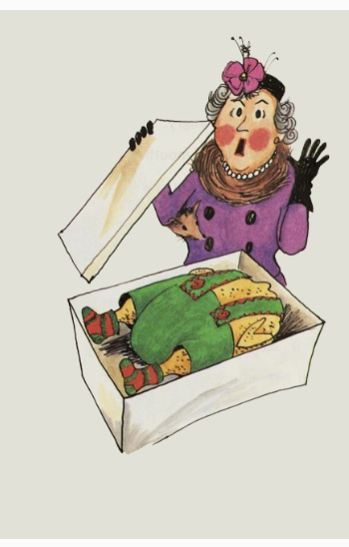
Amelia Bedelia
“The chicken – you dressed the chicken?” asked Mrs. Rogers. “Yes, and I found the nicest box to put him in,” said Amelia Bedelia. “Box!” exclaimed Mrs. Rogers. Mrs. Rogers hurried over to the box and lifted the lid. There lay the chicken. And he was just as dressed as he could be.

Slide 38
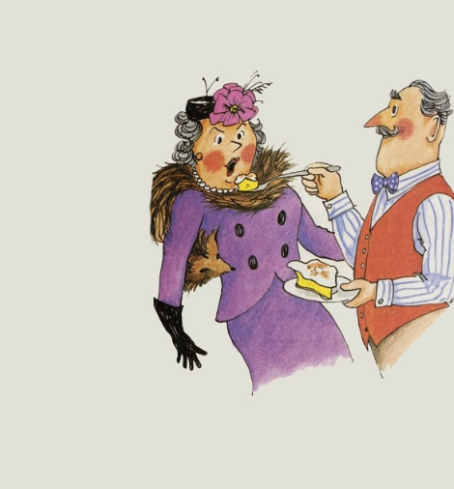
Amelia Bedelia
Mrs. Rogers was angry. She was very angry. She opened her mouth. Mrs. Rogers meant to tell Amelia Bedelia she was fired. But before she could get the words out, Mr. Rogers put something in her mouth. It was so good Mrs. Rogers forgot about being angry. “Lemon-meringue Pie!” she exclaimed.

Slide 39
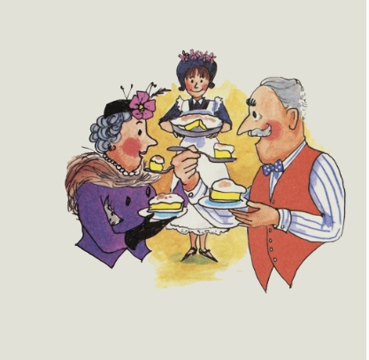
Amelia Bedelia
“I made it to surprise you,” said Amelia Bedelia happily. So right then and there Mr. and Mrs. Rogers decided that Amelia Bedelia must stay. And so she did. Mrs. Rogers learned to say undust the furniture, unlight the lights, close the drapes, and things like that. Mr. Rogers didn’t care if Amelia Bedelia trimmed all of his steaks with lace.
THE END

Slide 40
IDIOMS
Depending on how we say idioms, they can have several different meanings.
  If someone asks me how work was, I can say “Piece of cake!” (it was easy)
  If they ask me how my calculus test was I can say sarcastically “Piece of cake!” (it was hard!!)

Slide 41
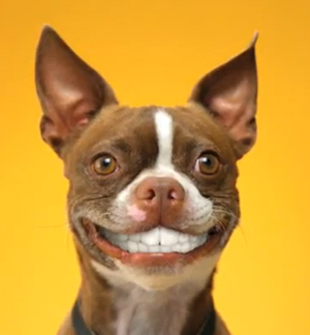
The End!
Any questions, comments?

